Slide 1
SSD Tools Strategy
Purpose: Identify and implement a set of tools that can be the foundation for common tools and processes to improve our workflow for efficiency and quality
Small team started investigating tools, with the intention to present a working prototype to a larger team for feedback
In process of setting up demonstrations of the prototype model
Prototype intended to function as a working model that other groups can use for evaluation

Slide 2
Proposed Changes to Development Stack
Functions | Applications/Tools | Comments
Task and bug tracking | Jira + Agile | Ver. 6.1, need licenses
Documentation (dev team) | Confluence | Need licenses
Code review | Gerrit | Open source
Continuous integration | Jenkins | Open source
Library management | Git | Open source
Compiler/Debugger | GHS | On order
Git/Gerrit/Jenkins:
Need headcount (small) for production implementation and administration
Atlassian:
Need headcount for process development, implementation and administration
Option: hire Atlassian consultant (wild guess: 2-4 months, $30K – $60K)
Atlassian tools license costs: approx. $30,000 for 500 licenses
Older hardware in place to get model up and running. Will evaluate possible improvements as part of learnings from prototype.

Slide 3
Rationale
Gerrit:
continuous integration pre-commit
automated workflow
Git:
tool of choice for distributed development teams
in the future, removes need for SVN/WANdisco costs on new programs
Gerrit/Jenkins/Git:
industry standard process
extensible framework
actively developed & well supported

Slide 4
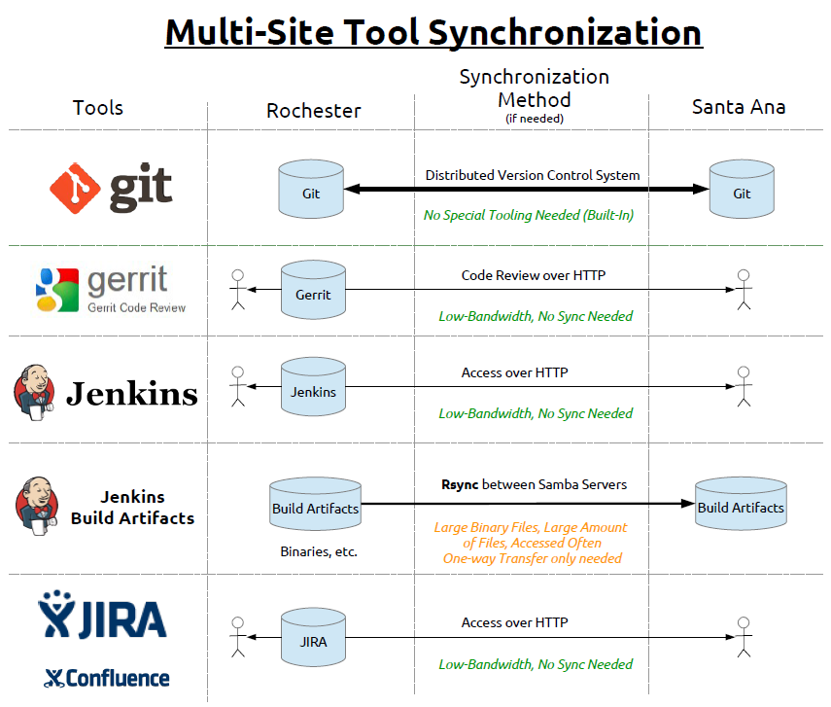

Slide 5
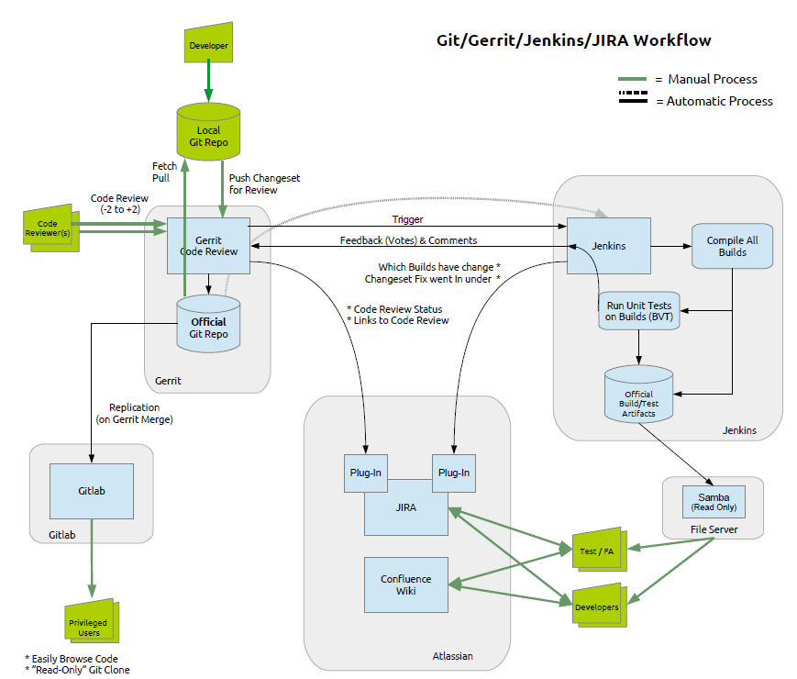

Slide 6
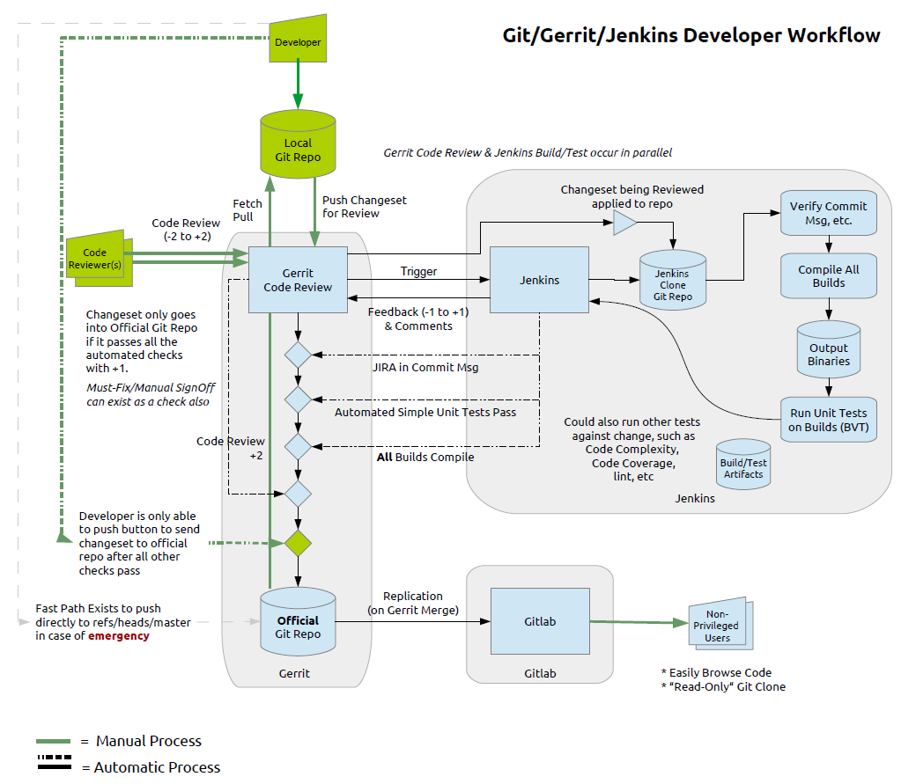
(add drawing)

Slide 7
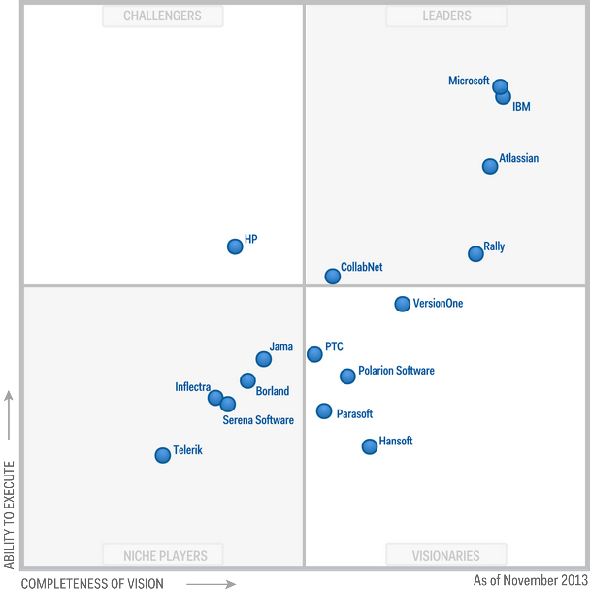
Summary of Atlassian in 2013 Gartner report http://www.gartner.com/technology/reprints.do?id=1-1MN598P&ct=131105&st=sb

Slide 8
